Slide 1

Flight Delay Prediction & Operations Optimization
Transforming aviation operations through predictive analytics and intelligent visualization
Predictive Solutions for Aviation Excellence
Mohan S
mohan.s.agnivamsha@gmail.com Business Intelligence Analyst Enthusiast

Slide 2

The Challenge: Aviation's $26 Billion Problem
Weather Disruptions
Airport Congestion
Unexpected storms and seasonal patterns causing cascade delays across networks
Limited runway capacity and gate availability during peak hours
Resource Constraints
Crew duty limits, maintenance windows, and ground handling bottlenecks
Current reactive reporting systems leave airlines constantly playing catch-up, resulting in passenger frustration and operational inefficiency.

Slide 3

The Financial Reality of Flight Delays
$26B+
Impact on Airlines
Fuel burn during extended ground operations
Annual Global Cost
Crew overtime and duty limit violations
Total impact of flight delays worldwide according to IATA data
Passenger compensation and rebooking costs
$74
Aircraft asset underutilization
Cost Per Minute
Average delay cost in U.S. aviation operations

Slide 4
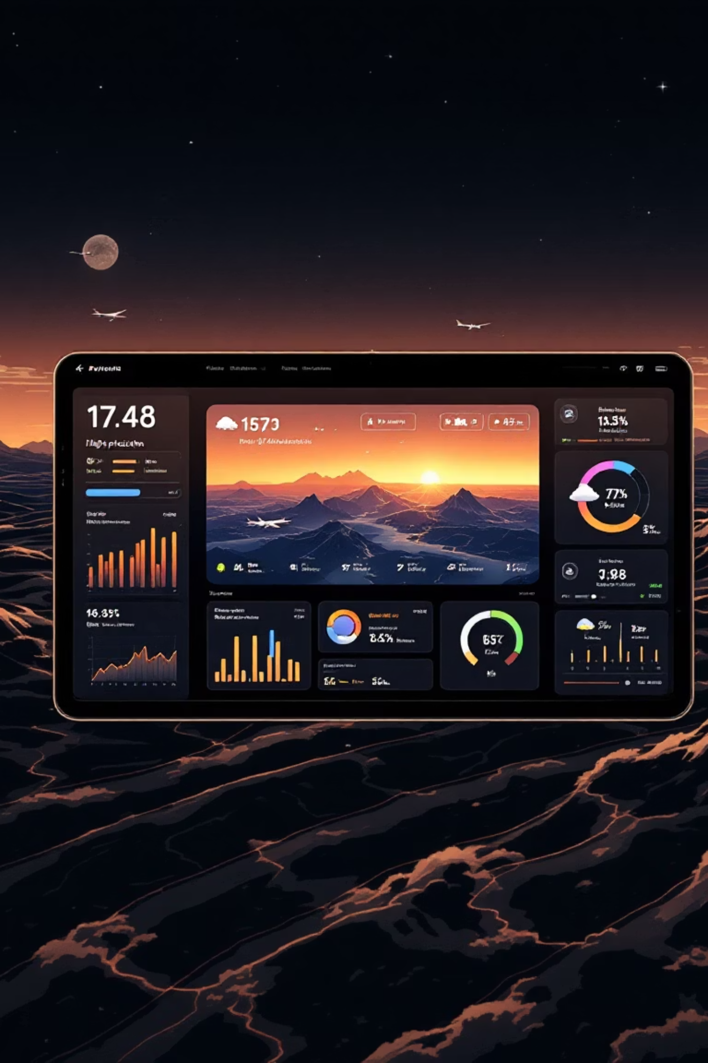
Our Predictive Solution Approach
01
02
Data Integration
Risk Prediction
Combine flight schedules, weather forecasts, and historical delay patterns into unified analytics platform
Machine learning models generate delay probability scores for every scheduled flight
03
Proactive Optimization
What-if simulations enable crew, gate, and turnaround time adjustments before delays occur

Slide 5




Comprehensive Data Foundation
Flight Operations
Weather Intelligence
Real-time schedules, aircraft rotations, block times, and turnaround requirements from airline systems
NOAA forecasts, historical patterns, and microweather conditions at origin and destination airports
Airport Operations
Historical Performance
Gate availability, runway congestion, ground handling capacity, and security checkpoint flows
BTS and FAA delay records, seasonal trends, and airline-specific operational patterns

Slide 6
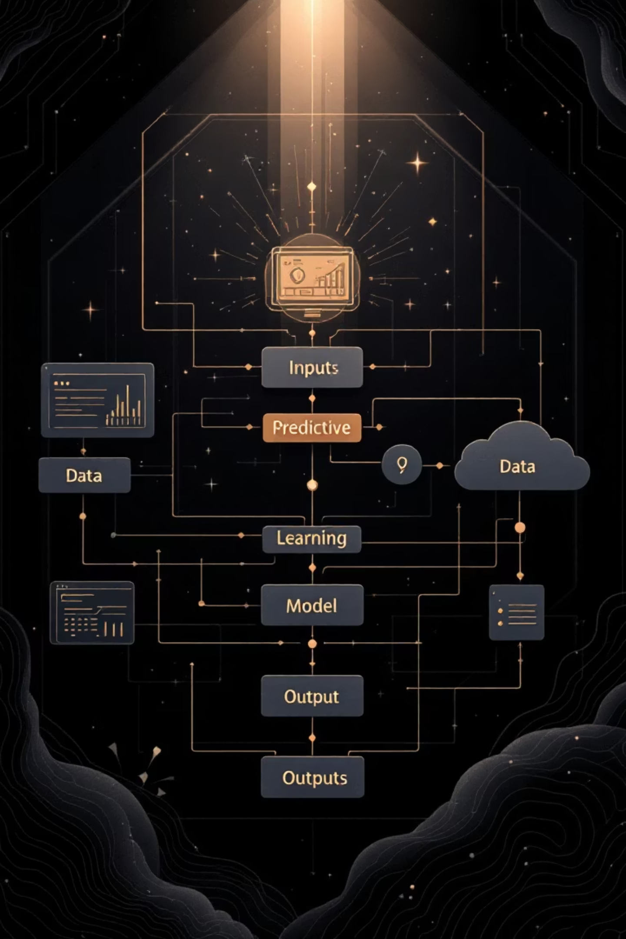
Machine Learning Analytics Engine
Predictive Features
Model Architecture
Origin-destination pair characteristics
Algorithm: Gradient Boosting with Random Forest ensemble
Time of day and seasonal patterns
Output: Delay risk score (0-1) with confidence intervals
Weather conditions and forecasts
Classification: Low, Medium, High risk categories with predicted delay minutes
Airport congestion levels
Crew availability and duty constraints
Aircraft maintenance schedules

Slide 7

Executive Operations Dashboard
Risk Heatmap
Alert System
Visual flight map with green, yellow, red coding based on delay probability scores
Real-time notifications for high-risk flights with recommended preventive actions
Performance Metrics
On-time performance trends, cost impact tracking, and operational efficiency indicators

Slide 8




What-If Simulation Capabilities
Scenario Planning
Test gate reassignments, crew swaps, and turnaround buffer adjustments
Impact Analysis
Quantify delay reduction, cost savings, and resource optimization outcomes
Decision Support
AI-powered recommendations for optimal resource allocation strategies
Example: Reallocating Gate 15 to Flight AA1234 reduces predicted delay from 45 to 15 minutes, saving $2,220 in operational costs.

Slide 9



Measurable Business Outcomes
25%
18%
35%
Delay Reduction
Cost Savings
Resource Efficiency
Proactive interventions preventing delays before they cascade
Reduced compensation, fuel burn, and crew overtime expenses
Optimized gate utilization and crew scheduling effectiveness
Enhanced passenger experience through reliable on-time performance and reduced disruptions drives customer loyalty and revenue protection.

Slide 10
From Delay Reporting to Delay Prevention
Phase 1: Foundation
1
Historical delay analytics and basic risk scoring dashboard deployment
2
Phase 2: Integration
Real-time weather feeds and airport operations data integration
Phase 3: Optimization
3
Full predictive capabilities with AI-powered prescriptive recommendations
Enabling Collins Aerospace to power predictive aviation operations
Ready to transform reactive reporting into proactive delay prevention through advanced analytics and intelligent visualization.

